Slide 1
Bayer & myHealthteam
MHT Menopause Community Review - Climara

Slide 2
AGENDA
Approach
Solution Overview
Insights and Findings
Additional Considerations & Next Steps
Q & A
Appendix

Slide 3
Approach
Goal: Extract a set of analytical data products to support Climara patient community analyses
Data
  2 [*.jsonl] files with ~10,000 MyHealthTeam Menopause Community Posts and Replies
    ~2,000 posts
    ~8,000 replies (*to provided parent posts)
  Included data attributes: Post/Reply - body, author, unique identifier and creation date
Solution
  Overview

Slide 4
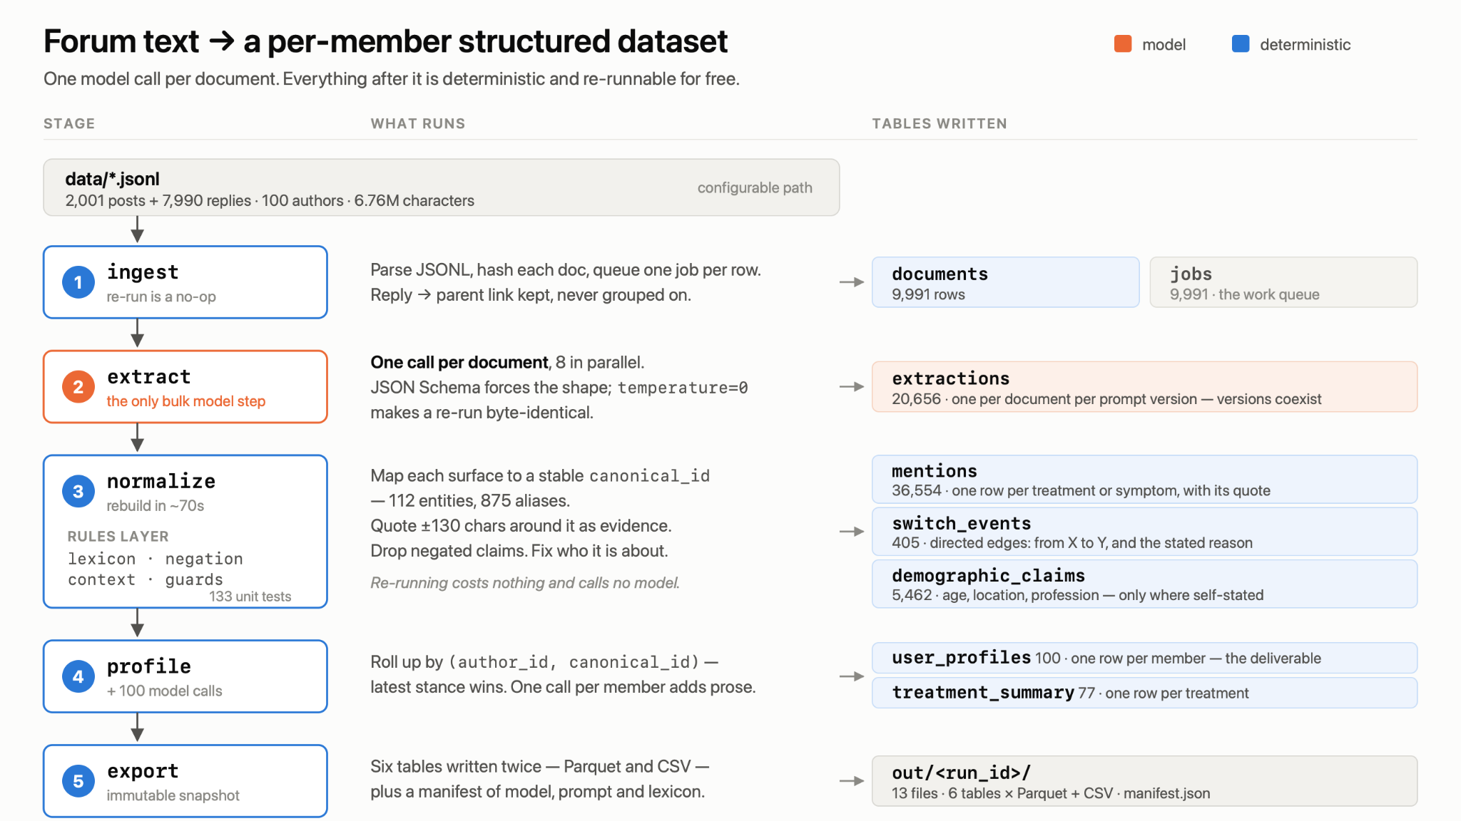

Slide 5
Approach
Assumptions/Caveats
  User-generated content (community forum posts) is assumed to be factual
  A “Climara patient” is defined as an author of a post or reply that makes a *self-reference to having taken Climara
    * Identification of self-reference is done by LLM named-entity recognition prompt
  “Sentiment” is categorized via LLM sentiment classifier prompt
Solution
  Performance Overview

Slide 6
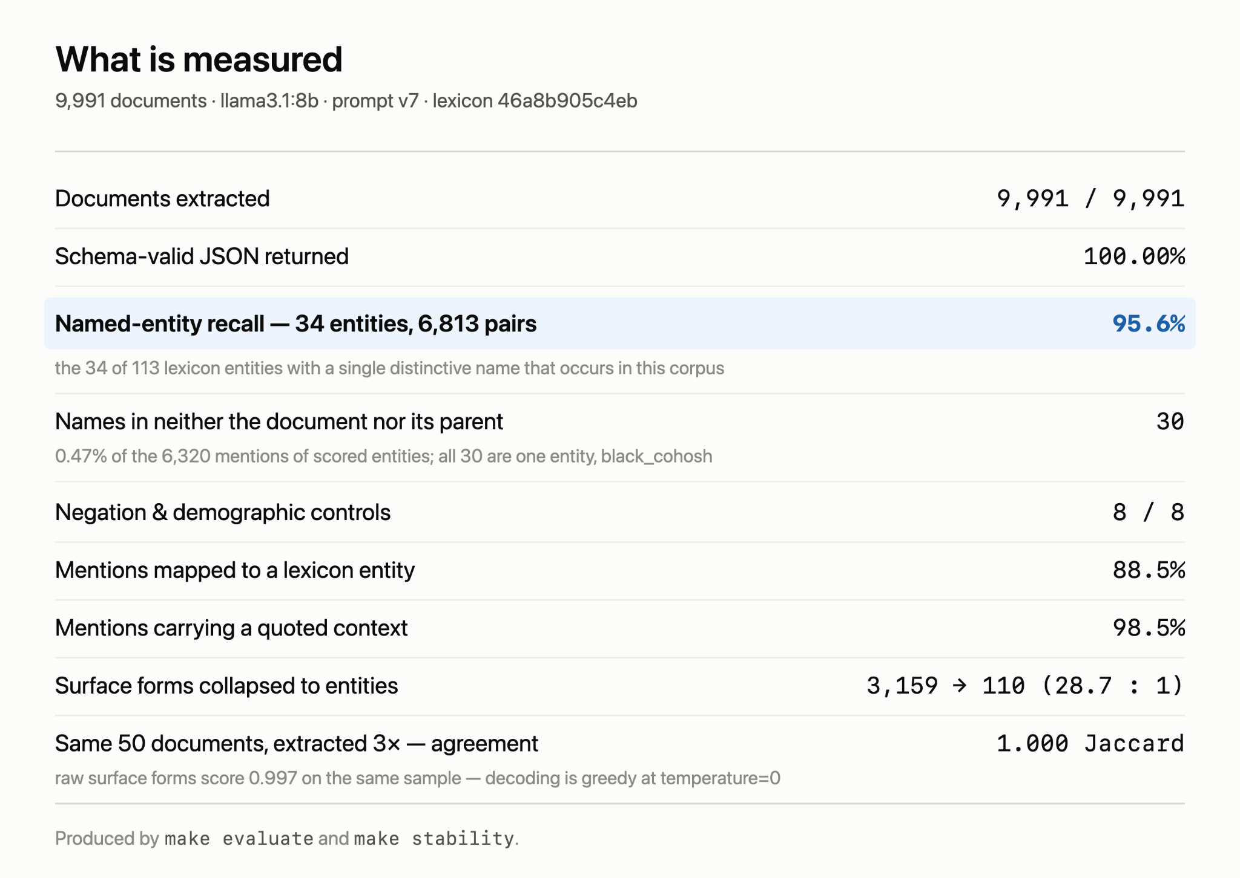
Guided Review Questions
(?) Who is the Climara patient in the community?
(?) How are community members feeling about Climara?
(?) What other treatments are members using?

Slide 7
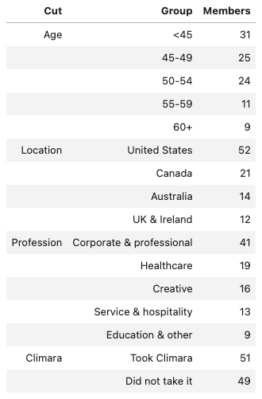
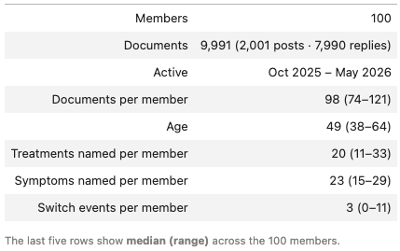
Insights and Findings
Who is the MHT Menopause Patient Community?

Slide 8
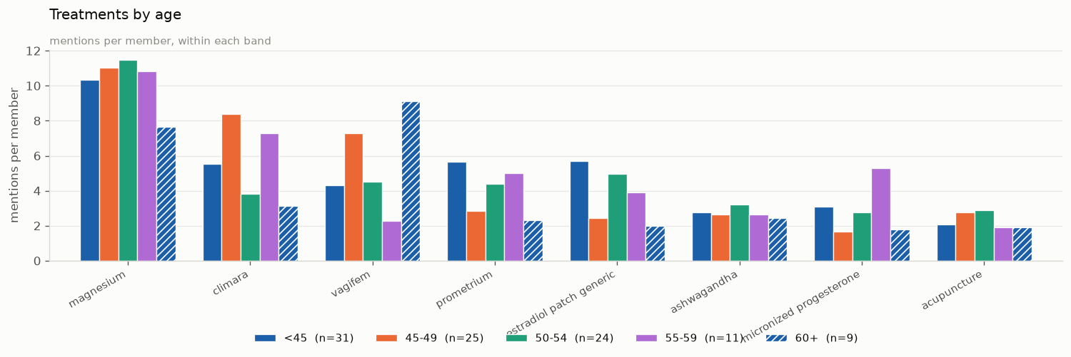
Insights and Findings
Who is the MHT Menopause Patient Community?

Slide 9
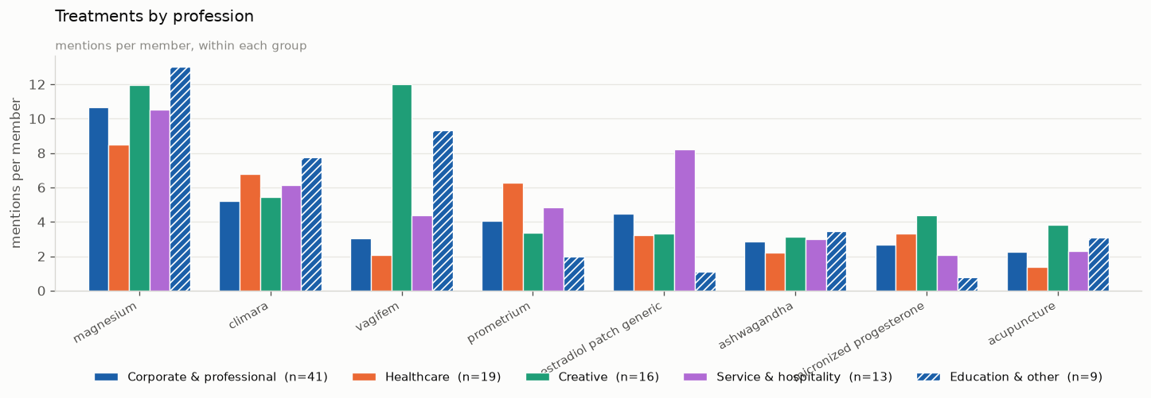
Insights and Findings
Who is the MHT Menopause Patient Community?

Slide 10
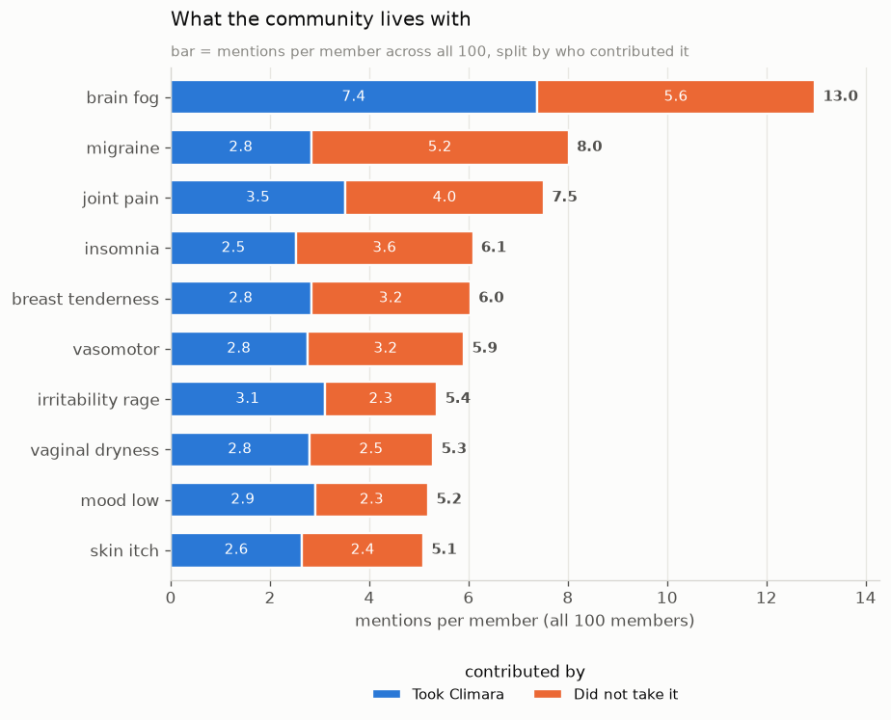
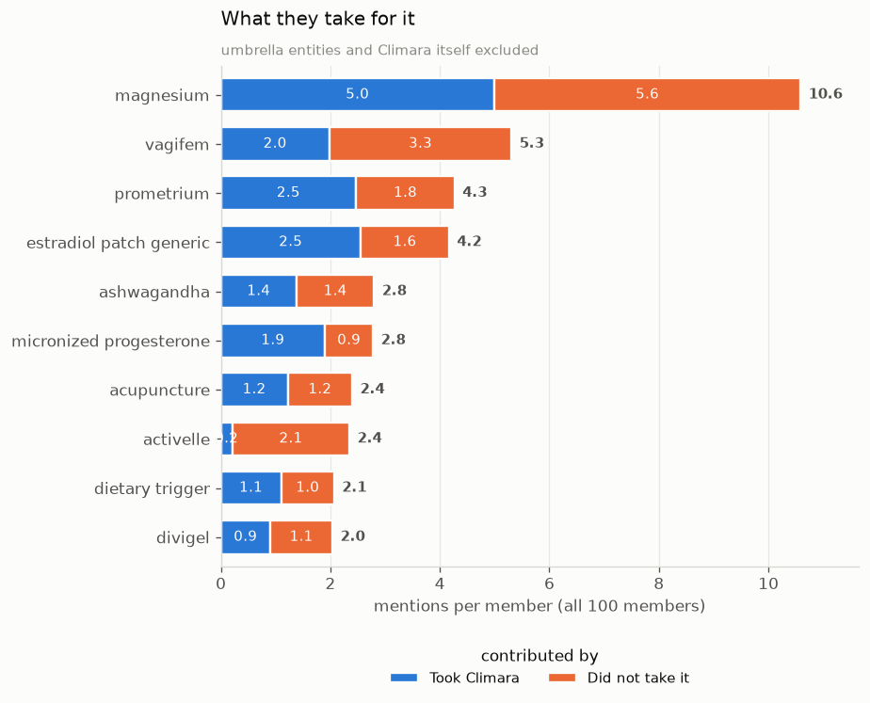
Insights and Findings
What is the Climara Patient Community experience?

Slide 11
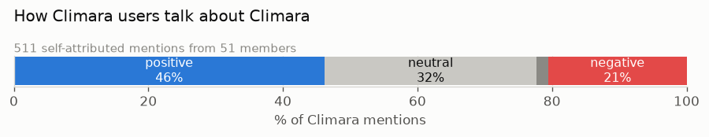
Insights and Findings
How does the MHT Climara Patient Community feel about the treatment?

Slide 12
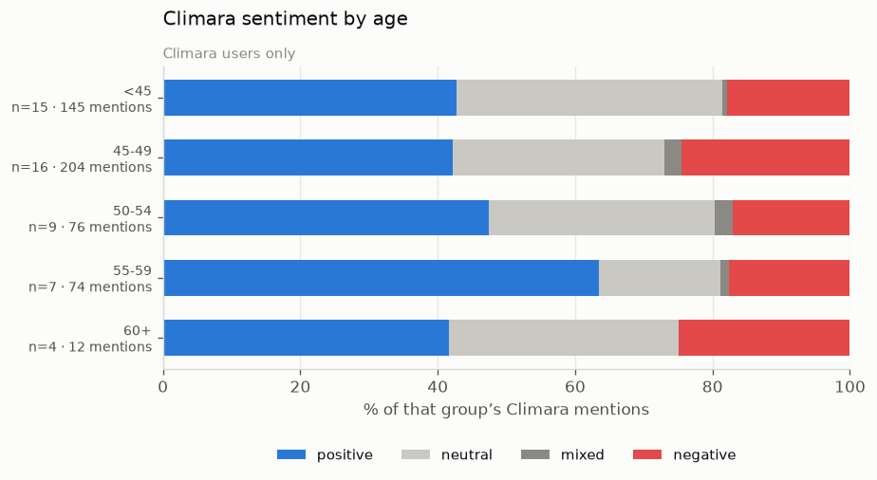
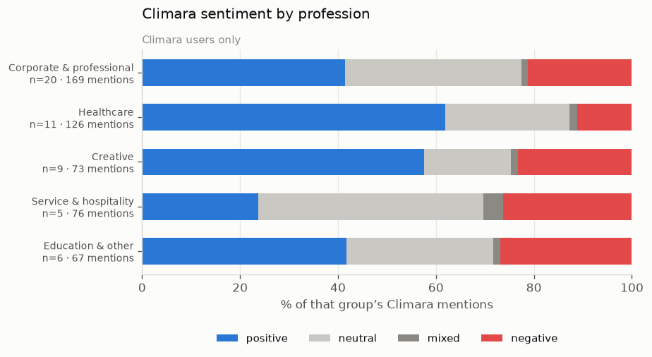
Insights and Findings
How does the MHT Climara Patient Community feel about the treatment?

Slide 13
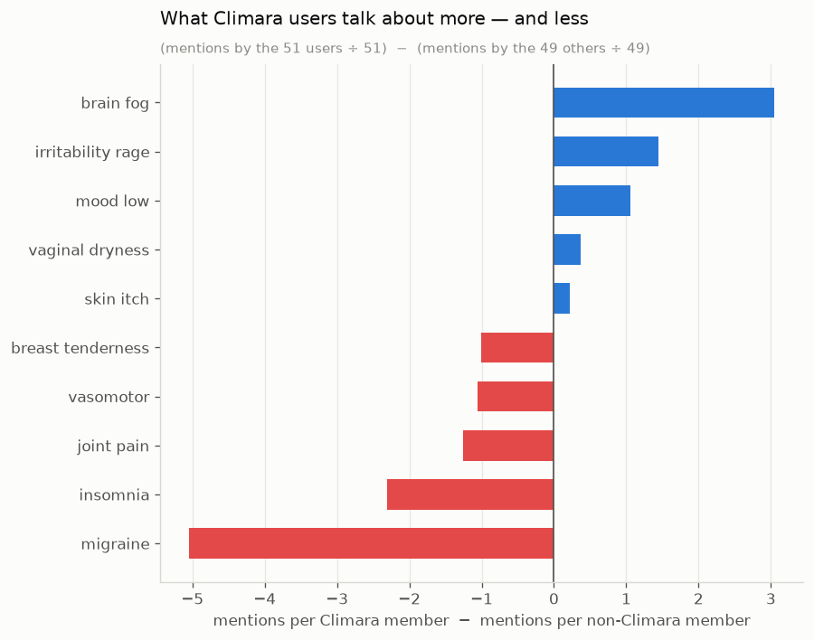
Insights and Findings

Slide 14
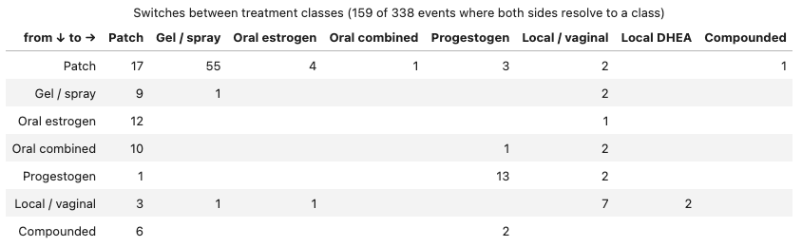
Insights and Findings
What treatments do the MHT Patient Community switch TO and FROM?

Slide 15
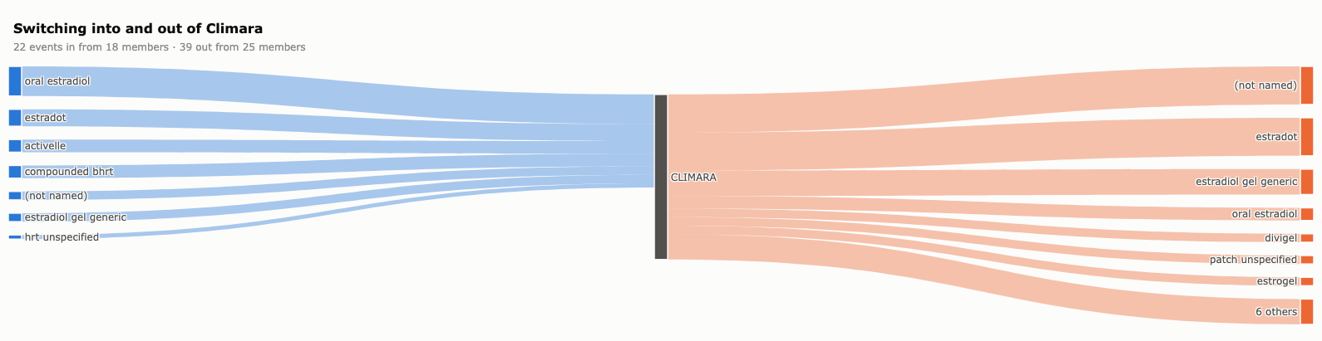
Insights and Findings
What treatments do the MHT Climara Patient Community switch TO and FROM?

Slide 16
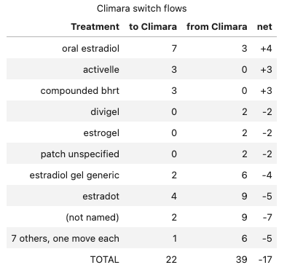
Insights and Findings
What treatments do the MHT Climara Patient Community switch TO and FROM?

Slide 17
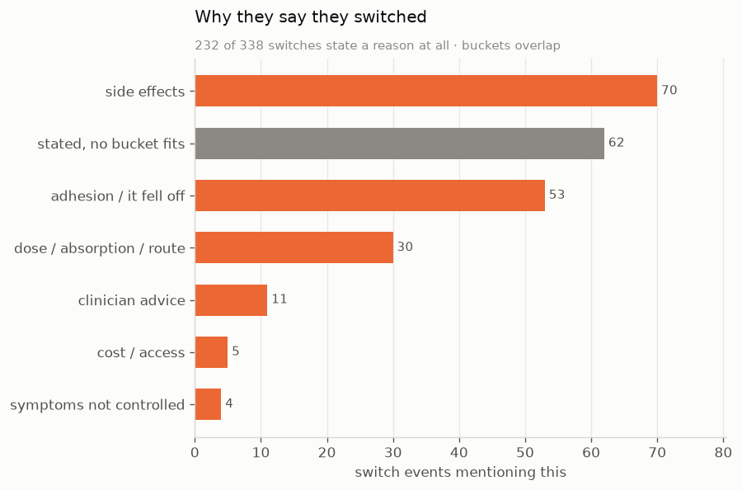
Insights and Findings
Why does the MHT Menopause Patient Community switch treatments?

Slide 18
Additional Considerations & Next Steps
Scaling for Production
  Keep as LLM/agent-based → vLLM on cloud compute ⇒ 37 million posts for < ~$5,000, ~3-8 days
Validation
  More human review if given more time
  “lexicon” configuration vs. MHT Medical Ontology Reference database
  “domain” configuration vs. MHT internal knowledge reference(s)
Analytical Data Products
  Switch Events - Refine prompt; more quality measures/tests
  Enrichment - Try to extract additional output:
    Efficacy
    Dosage
  Ontology mappings

Slide 19
Q & A
Thank you for your time! What questions do we have?

Slide 20
APPENDIX

Slide 21
Sentiment - Member Comments
=== POSITIVE ===
· …I'm not going to offer anything except — yes. This is grief and it's real and it deserves
to be called what it is. I'm on the Climara patch now and it's helped the rage a bit but it
hasn't fixed the feeling of being a stranger to myself, so I know that part isn't just…
· I made exactly this transition about two years ago — Vagifem plus added Climara patch, and
then Prometrium. First month: breast tenderness yes, quite noticeable, lasted roughly six
weeks for me. Bloating was a…
· …me. Also did the iron supplementing cause any stomach issues? I'm already anxious about
adding anything new on top of the Climara. Really glad you found something that works
though, 1-2 nights vs 5-6 is massive.
=== NEGATIVE ===
· temple hair loss getting worse even on the patch — anyone else?? okay so i've been on the
Climara patch for almost 8 months now and i genuinely thought it would help slow down the
hair loss at my temples but honestly?? it seems like…
· …exhausting, especially doing detailed design work through daily headaches 💛 I stopped
briefly about two years before starting my Climara patch and honestly the muscle aches were
the thing that surprised me most — I didn't even realize HRT had been helping with them
until…
· …good evidence for meibomian gland dysfunction. I'm filing this away because my allergies
have been flaring since starting the Climara patch and my eyes are part of it.

Slide 22
Switch Events - Member Comments
22 of 338 switch events met the selection criteria; showing 5
SELECTION CRITERIA: Must carry a first-person movement construction, both endpoints must resolve to named products, and the surrounding text must not attribute the move to someone else
vagifem → imvexxy [applicator faff]
“Switched from Vagifem to Imvexxy a while back mostly because of applicator faff tbh”
activelle → climara [reduce first-pass hepatic effects]
“switching from oral to transdermal estrogen”
estradot → estradiol gel generic [thinking transdermal might be gentler]
“Switched to estrogen gel thinking transdermal might be gentler.”
prometrium → mirena
“switching to a Mirena IUD for the progestogen component”
vagifem → intrarosa [anecdotally the urgency did settle a bit more]
“Switched to Intrarosa when my compounding clinic suggested it”

Slide 23
User “switch event” - Reason Text Mapping
# The stated reasons, in members' own words. `reason` is free text with no
# canonical form - `adhesion issues` (47) and `adhesive issues` (6) are separate
# strings - so it is bucketed by regex rather than grouped. The patterns were
# widened against the actual unmatched values: efficacy is written as "breaking
# through", "not responding" and "wasn't resolving", never as "not working".
BUCKETS = {
'side effects': (r'tender|bleed|migraine|headache|nausea|bloat|irritat|rash|mood'
r'|adverse|side effect|ache|hair'),
'adhesion / it fell off': r'adhes|stick|peel|fall|fell off|came off|applicator',
'dose / absorption / route': (r'dose|absor|level|consistenc|strength|titrat|route'
r'|transdermal|systemic|peak|trough|hepatic'),
'clinician advice': r'doctor|gp|specialist|consultant|provider|nams|advice',
'cost / access': r'cost|price|insur|cover|afford|supply|shortage',
'symptoms not controlled': (r'not work|didn.t work|wasn.t work|no relief|ineffect'
r'|stopped work|nothing|breaking through|not respond'
r'|wasn.t respond|weren.t resolv|wasn.t resolv|got worse'
r'|unsustainable|wasn.t right'),
}

Slide 24
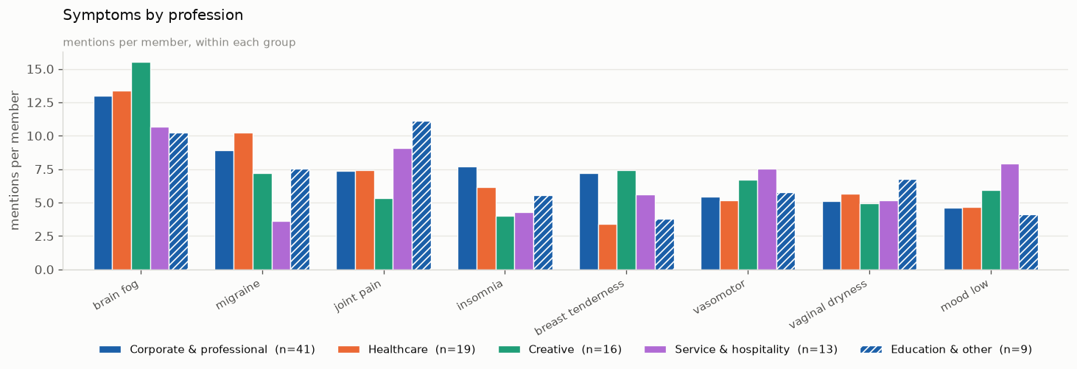
Insights and Findings
Who is the MHT Menopause Patient Community?

Slide 25
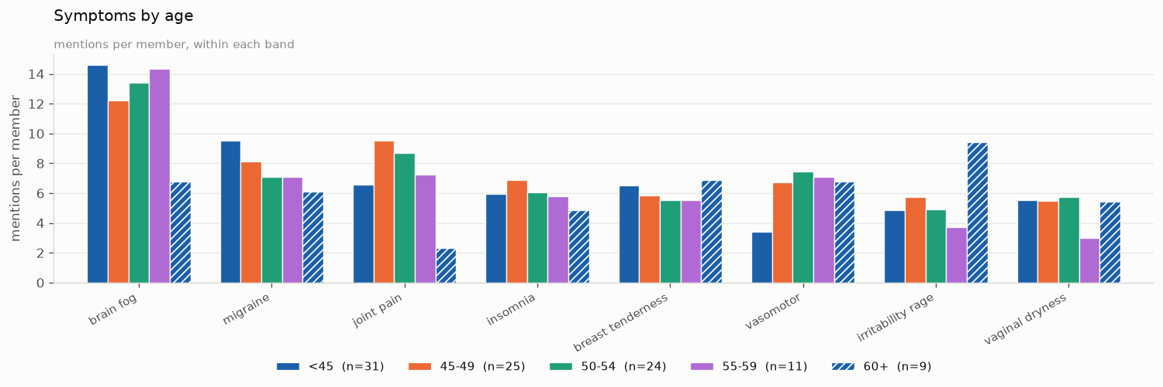
Insights and Findings
Who is the MHT Menopause Patient Community?

Slide 26
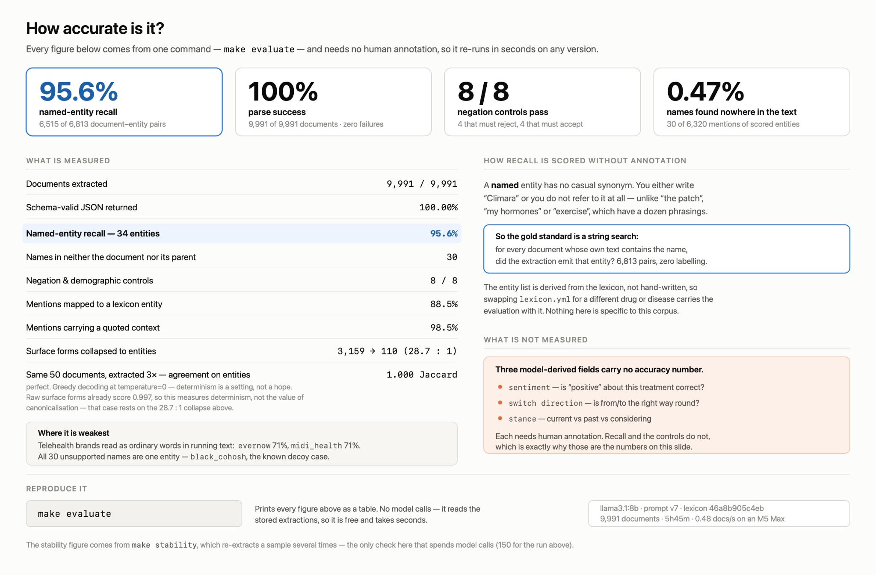

Slide 27
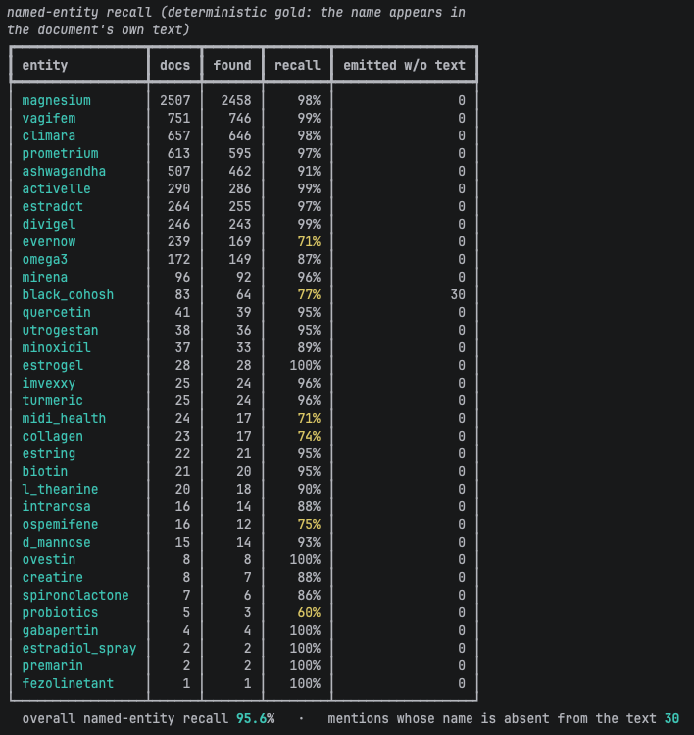

Slide 28
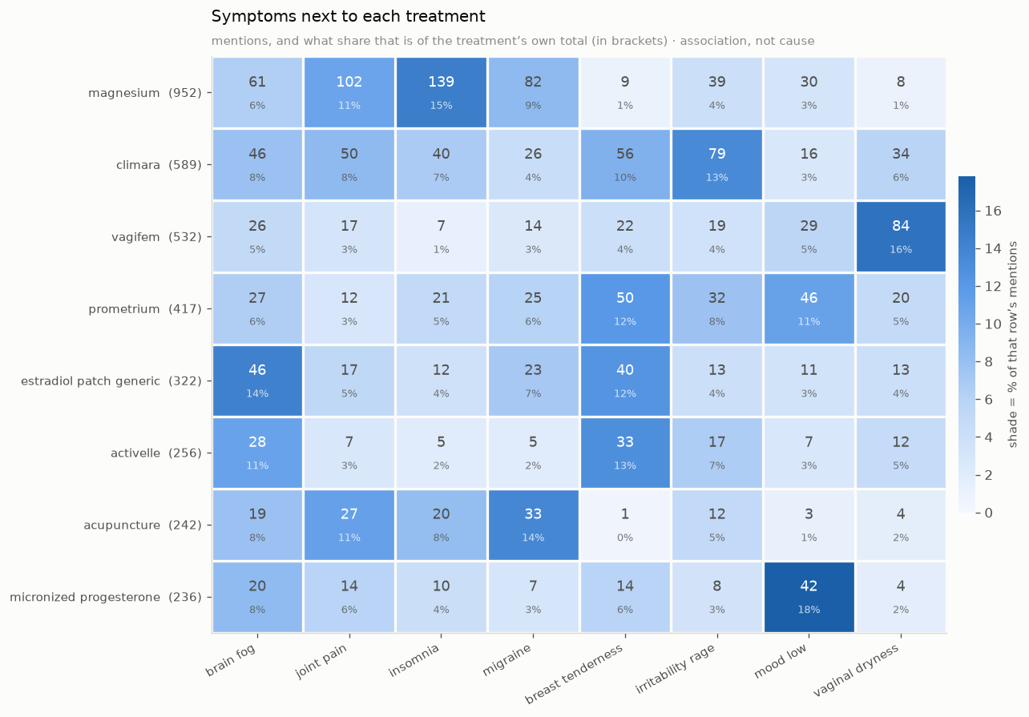
Insights and Findings

